Slide 1
Session #27: Calibrating Self-Supervised Models
Tuesday, November 29
CSCI 601.771: Self-supervised Statistical Models

Slide 2
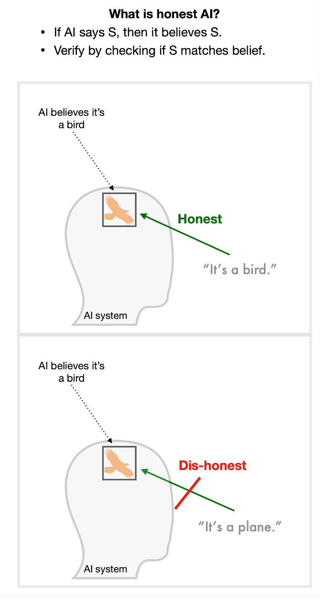
Motivation
Desire AI systems that are honest
They know what they do and don't know with appropriate confidence
✍️: Iliana

Slide 3
Motivation
Desire AI systems that are honest
They know what they do and don't know with appropriate confidence
Experiments
Calibration
Self-evaluation
Self-knowledge
✍️: Iliana

Slide 4
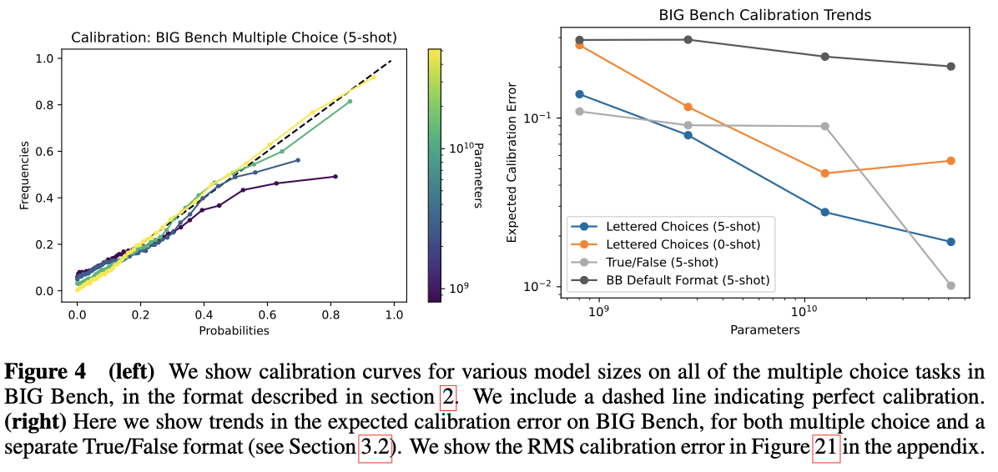
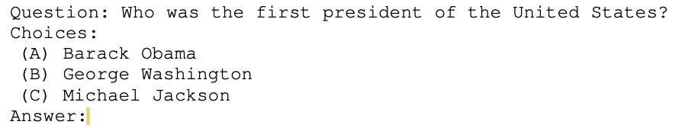
Calibration
Calibrated when probability assigned to outcomes matches the frequency of the actual outcomes.
✍️: Iliana

Slide 5
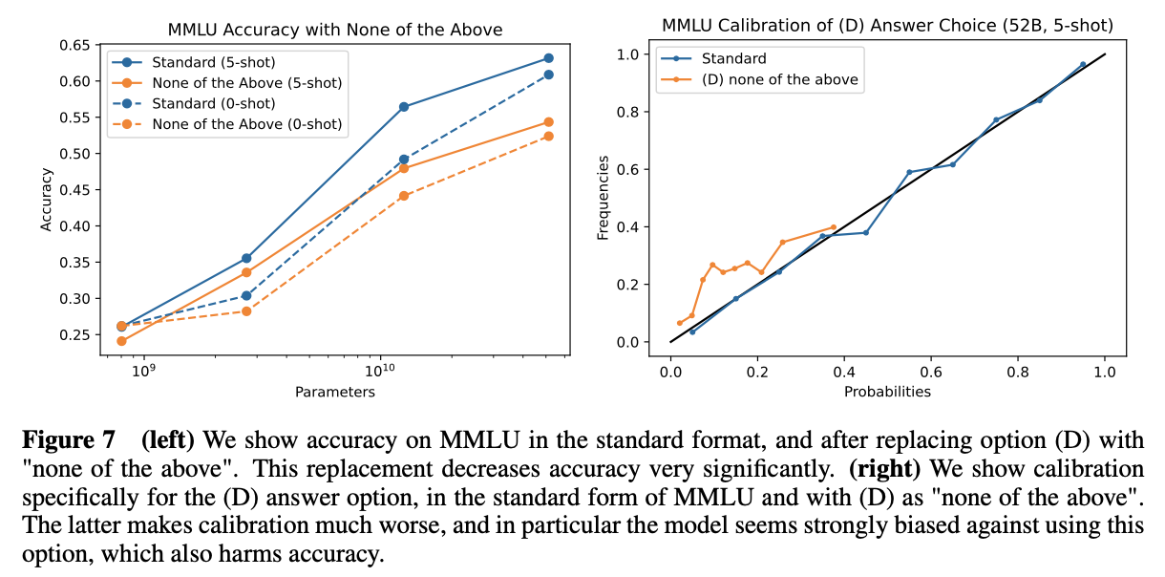
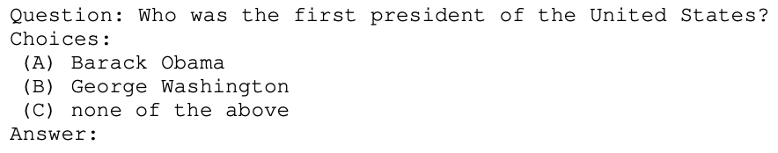
Knowing What You Know
Does the model know if each answer option is correct?
Include a "none of the above" option
✍️: Iliana

Slide 6
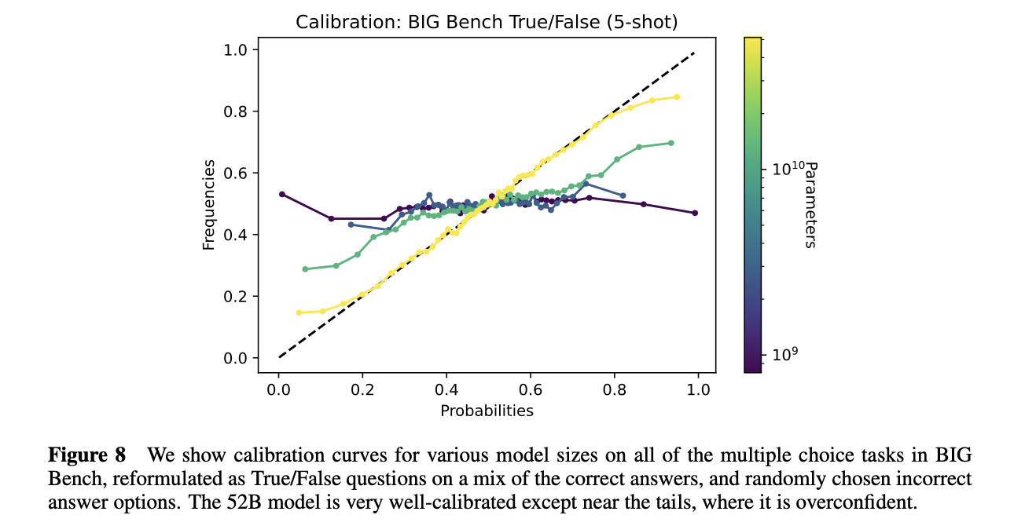
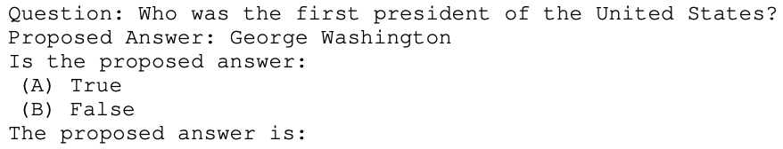
Knowing What You Know
Switch to True/False
Improves calibration for large models
✍️: Iliana

Slide 7
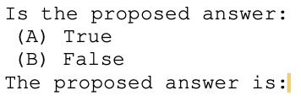
Is Your Answer True or False?
Can we ask language models about their own outputs?
Ask Question
Sample a model response
Ask model about sampled response
Samples from smaller models are easier to categorize as correct/incorrect
Zero-shot P(True) is poorly calibrated
~ 50% for most samples
✍️: Iliana

Slide 8
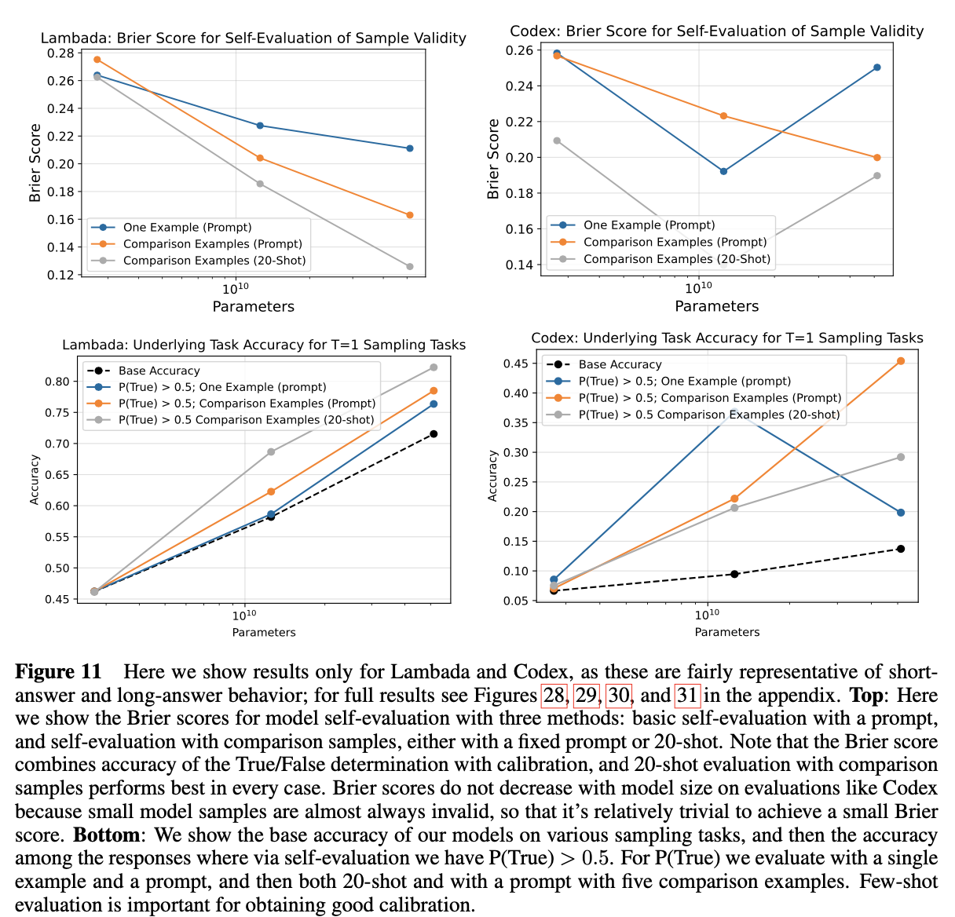
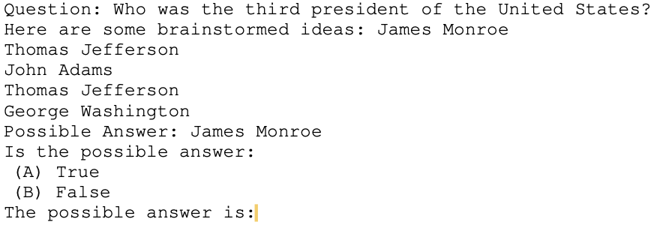
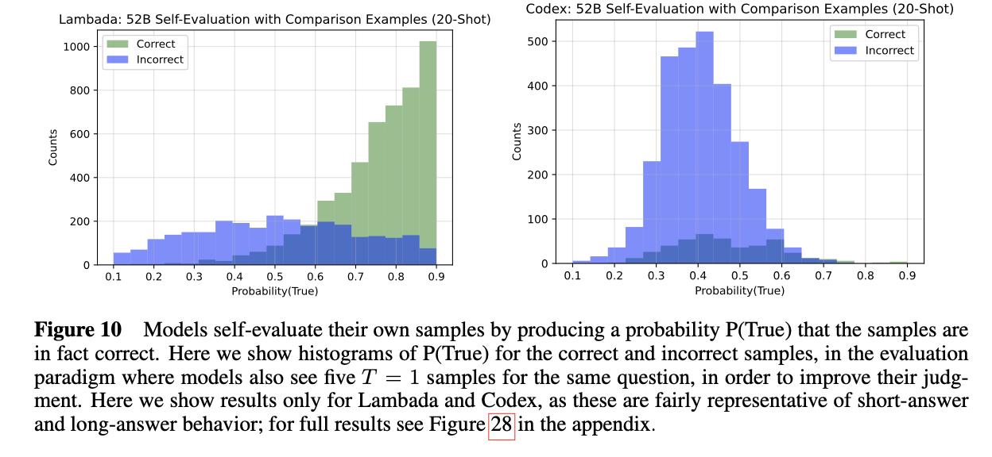
Is Your Answer True or False?
Generate 5 sample answers from model and ask about validity of one.
Improves performance, but is still poor for zero-shot.
✍️: Iliana

Slide 9
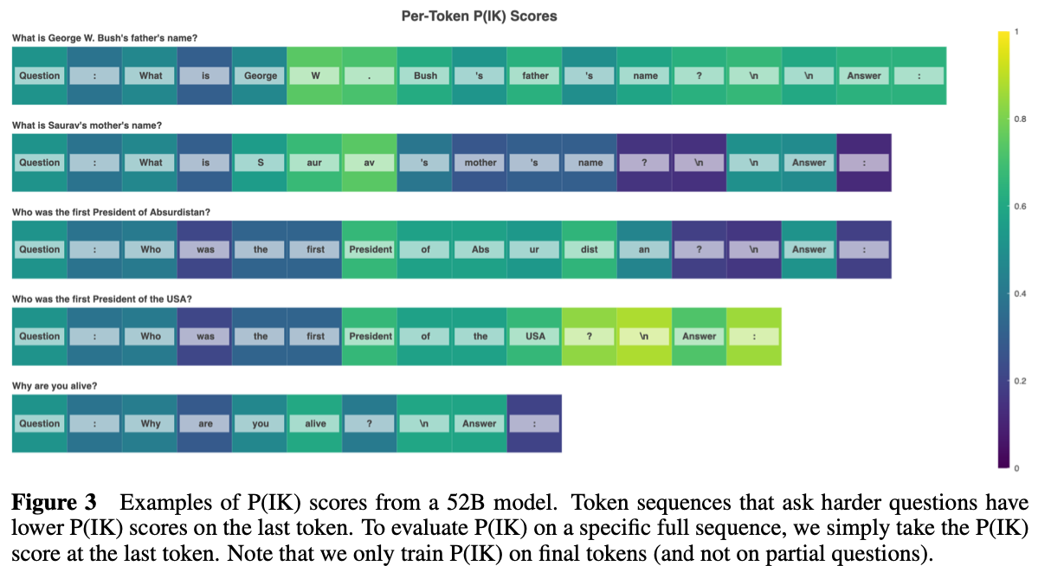
Prediction of Knowledge
Two approaches
Value Head – train P(IK) as logit from additional value "head" added to the model
Natural Language – train P(IK) by asking model what confidence they could answer a question
Train model to predict whether they know the answer to a question
P(IK) - Probability of "I know the answer"
✍️: Iliana

Slide 10
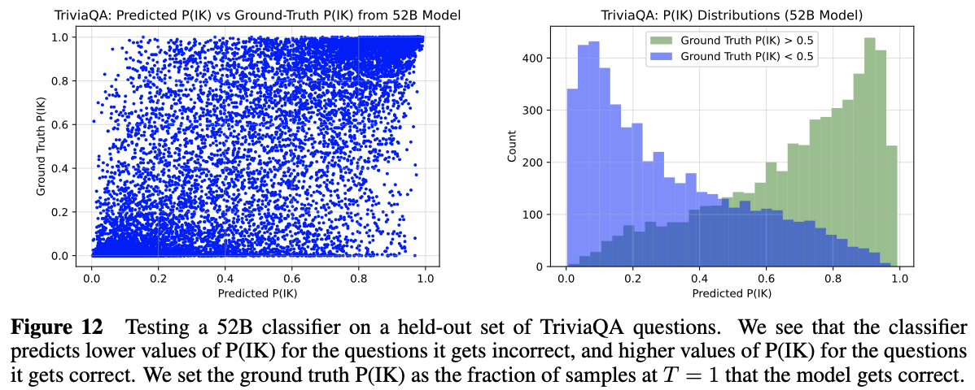
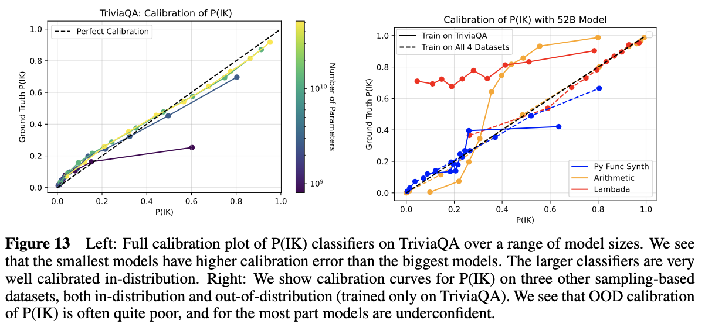
Prediction of Knowledge
✍️: Iliana

Slide 11
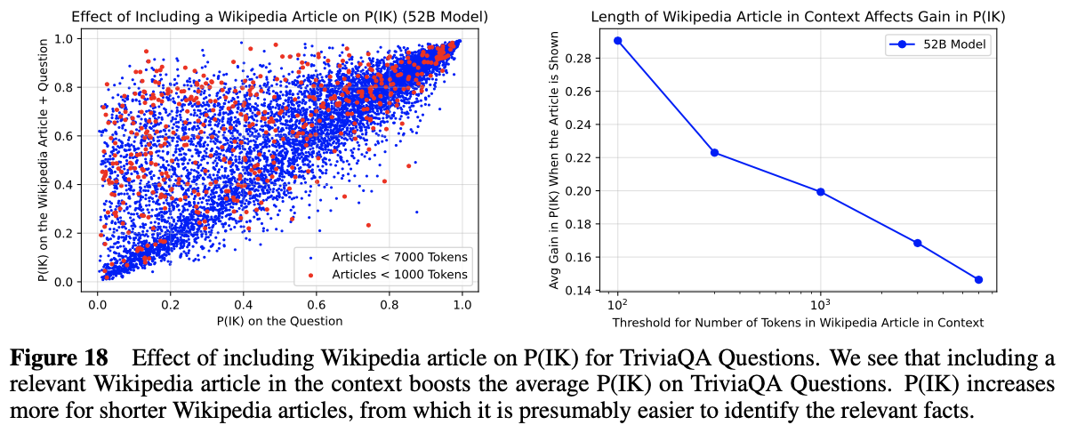
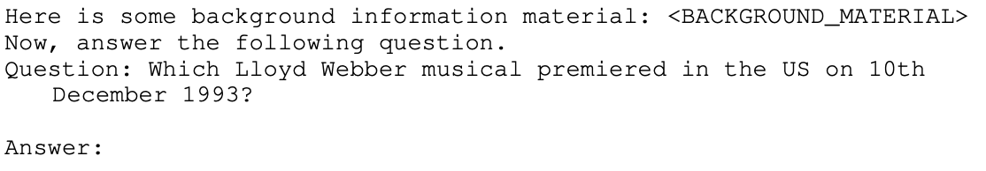
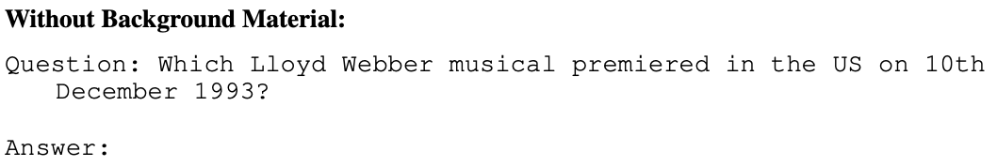
Prediction of Knowledge
For obscure questions, does including source material help P(IK)?
Compute P(IK) with background material
Compute P(IK) without background material
✍️: Iliana

Slide 12
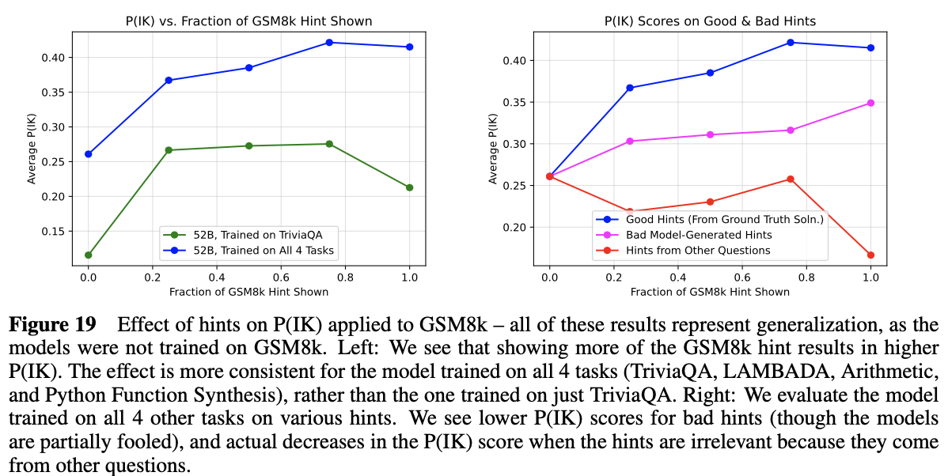
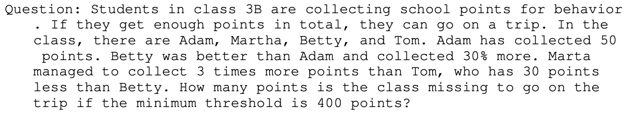
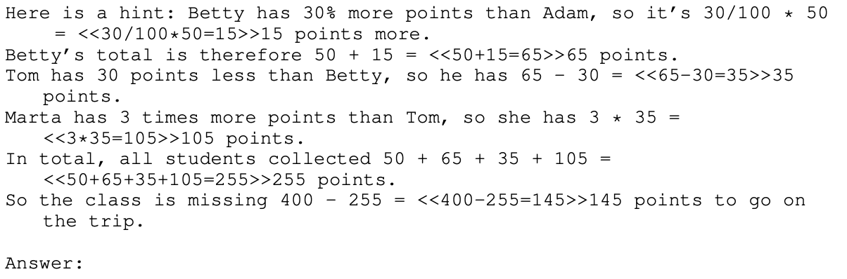
Prediction of Knowledge
For the hardest dataset GSM8k, can adding hints help performance?
Two types of hints
Vary amount of information in hint
Create good, incorrect, and distracting hints
✍️: Iliana

Slide 13
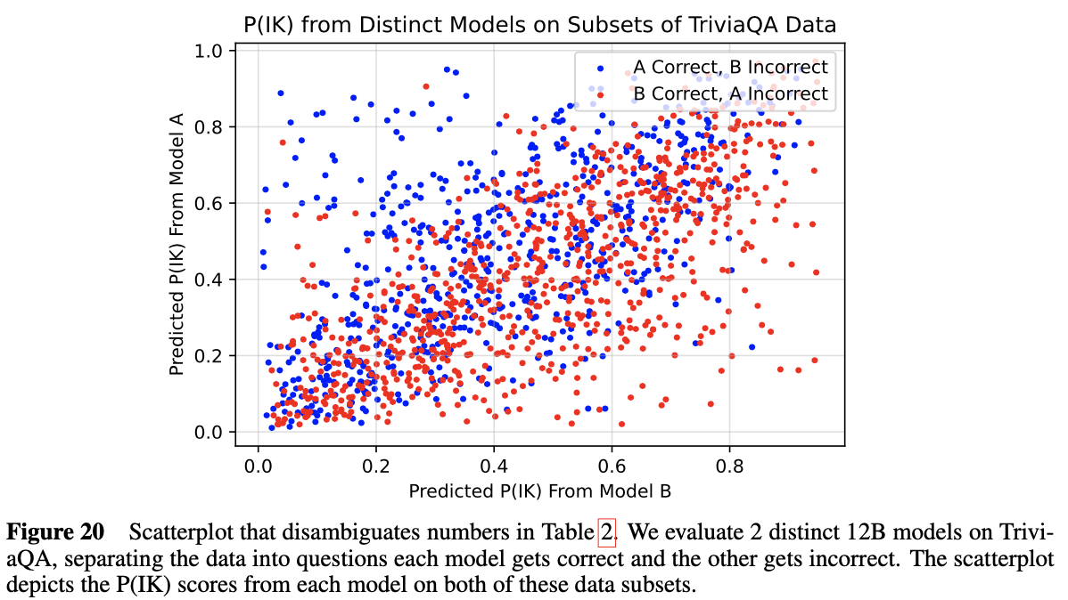
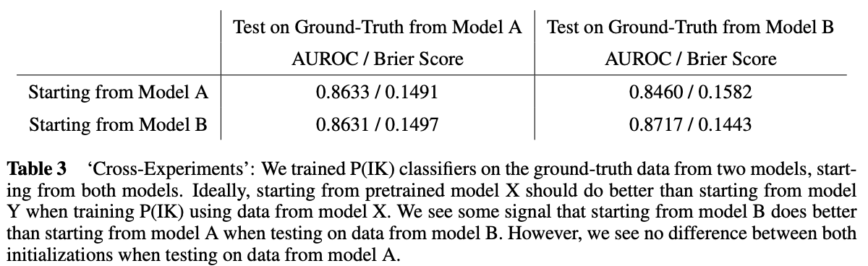
Prediction of Knowledge
Is the P(IK) model truly capturing self-knowledge?
Train two models on different data distributions
Four repetitions of high-quality dataset
Single copy of high-quality dataset mixed with lower-quality distribution of web data
Each model has higher P(IK) on questions that model alone gets right compared to the other model's uniquely correct questions
Second experiment – finetune both models on ground truth from each model.
✍️: Iliana

Slide 14
Empiricists
https://colab.research.google.com/drive/1YIcelfDdNx6WxnK-T3wwinWtEI_HkVC9?usp=sharing
👩🏽‍🔬: Vicky & Isabel

Slide 15
Strengths
Quite exhaustive (models, datasets, experiments)
Levels of study:
Simple Calibration tests
Asking models to evaluate their own predictions; calibration tests on top.
...
Metacognition/Meta question: a deeper level
🔎: TBD

Slide 16
Weaknesses
Did not attempt to address some findings like:
"None of the above"
Temperature adjustment fix
Natural language P(IK) seems unmotivated and unnecessarily mentioned.
Calibration vs Prompt Engineering.
Focusing on history, not many up-to-date knowledge
Do models know whether they know who is the president of US now?
🔎: TBD

Slide 17
Pros and cons
Diagram which support its idea and make comparison.
The article did not mentioned how they select the hyperparameter of the training model, and they just show the results of the mathematical , but no proof.
There are so many definition variables which might make the article more complicated
We suppose there only one answer is correct
Models are Well-Calibrated on True/False Tasks
🔭: TBD

Slide 18
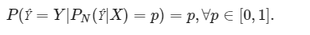
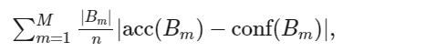
Visionary
Calibration
Bucket
Abstention
Acc: accuracy
Conf: model confidence (e.g. P(IK) or P(True))

Slide 19
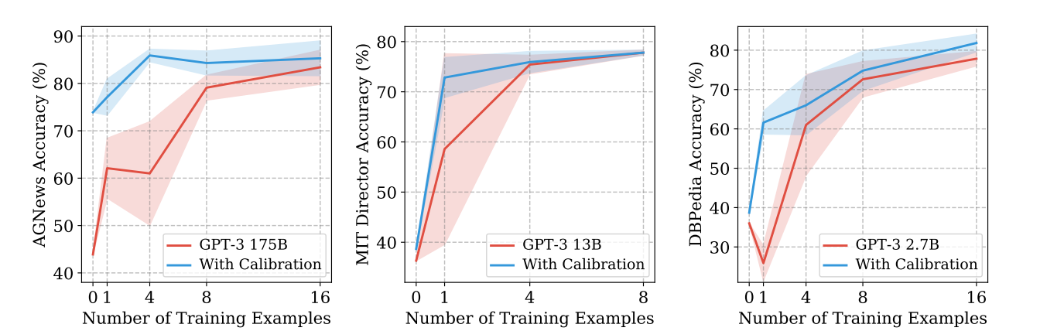
Visionary
Calibration methods
Calibrate P(True) , "calibrate before use"

Slide 20
Visionary
Calibration methods
Calibrate P(True)
P(IK) or P(True) is baseline, better calibration methods?
Sensitivity
Mutual Information
Flatness

Slide 21
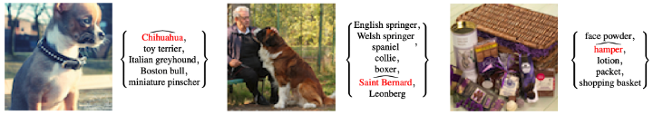
Beyond Calibration: Uncertainty Quantification/Conformal Prediction
Guarantee to cover the true value with high probability
P(prediction in a set) > some probability
For a desired probability, what is the set in which the answer is guaranteed to exist?
More detailed understanding of model probability space
https://towardsdatascience.com/conformal-prediction-4775e78b47b6

Slide 22
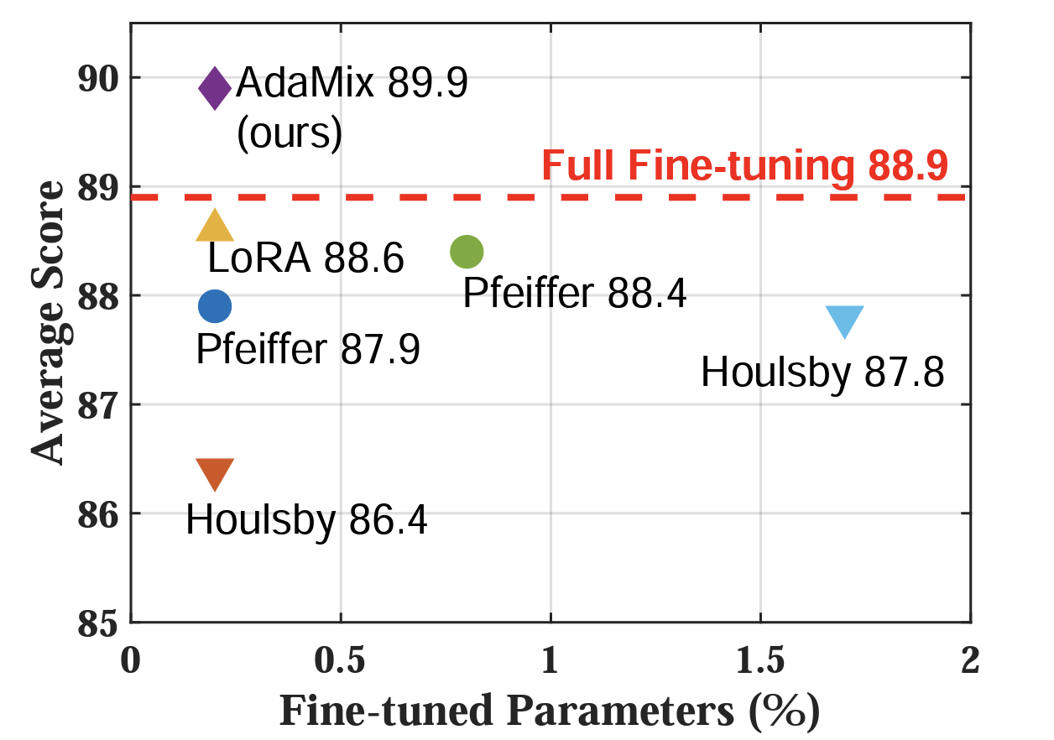
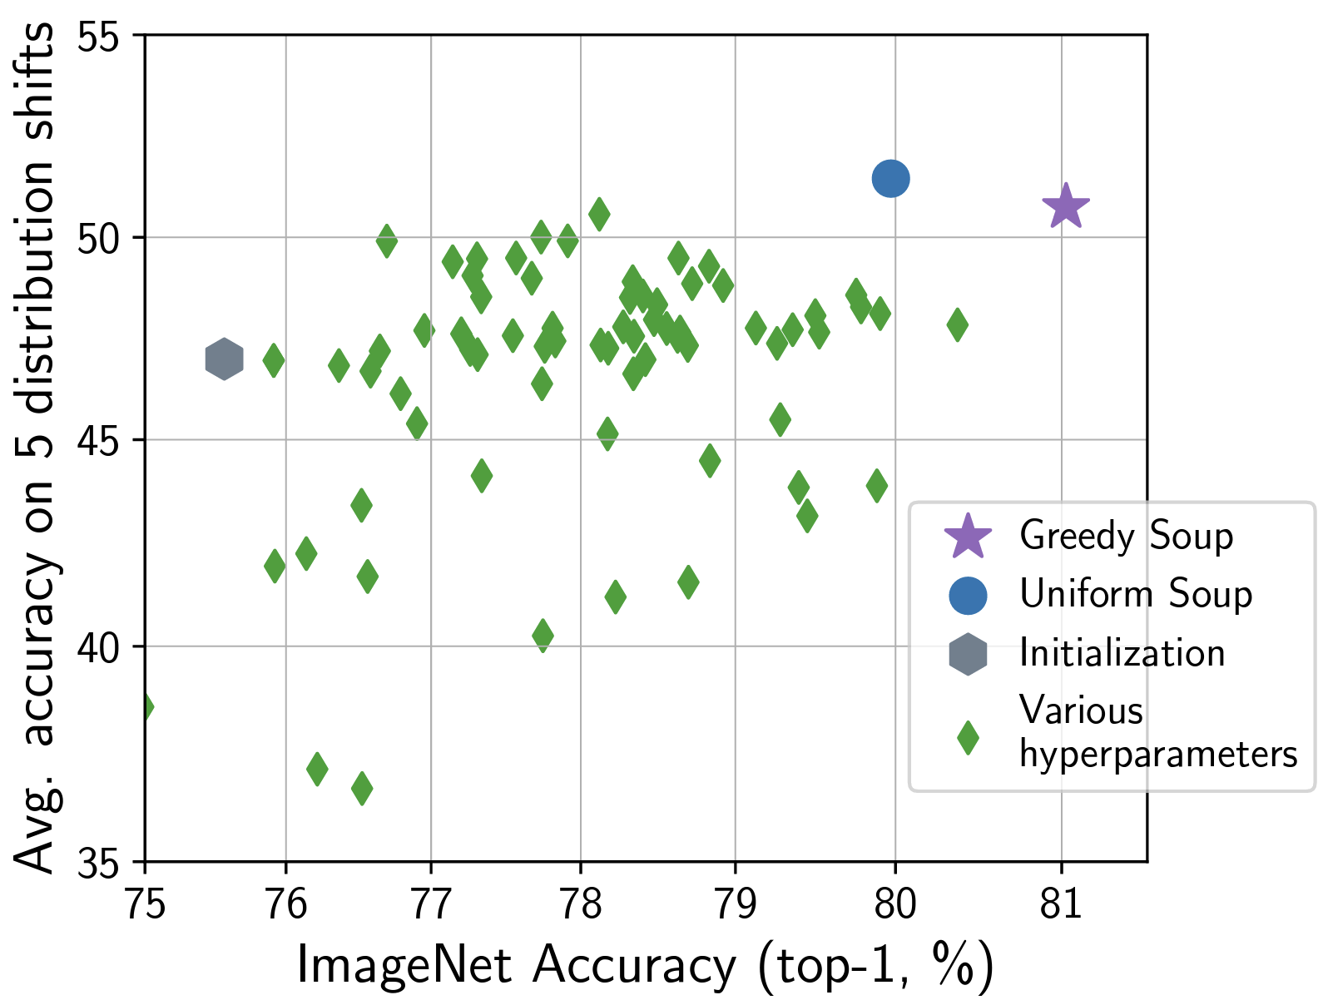
Is Model Soup Well Calibrated?
Model Soup:
Averaging weights of multiple models with different parameters
AdaMix:
Mixture of Adapters
Extension:
How well are these models calibrated?
What about Model soup of LLMs?

